Slide 1
CHAPTER 1
DISPLAY DEVICES , RANDOM AND RASTER SCAN SYSTEMS

Slide 2
History
A cathode-ray tube, often called a CRT, is an electronic display device in which a beam of electrons can be focused on a phosphorescent viewing screen and rapidly varied in position and intensity to produce an image.
Probably the best-known application of a cathode-ray tube is as the picture tube in a television.
Other applications include use in oscilloscopes, radar screens, computer monitors, and flight simulators.

Slide 3
The cathode-ray tube was developed in 1897 by Ferdinand Braun of Strasbourg in what was then the French-German region of Alsace-Lorraine.
It was first used as an oscilloscope to view and measure electrical signals. In 1908, A.A. Campbell-Swinton of England proposed using a CRT to send and receive images electronically.
It wasn't until the 1920s, however, that the first practical television system was developed.
The concept for a color cathode-ray tube was proposed in 1938 and successfully developed in 1949.

Slide 4
Although General Electric introduced their first television set for home use in 1928, commercial television broadcasting remained an experimental technology with only limited range and audience.
It took until the late-1940s before television net-works had established themselves sufficiently to start a boom in consumer sales.
Black-and-white television sets gave way to the first color sets in the 1960s. In the following decades cathode-ray tubes for televisions got both larger and smaller as manufacturers sought to satisfy consumer wants

Slide 5
Overview
Display Hardware
  How are images displayed?

Slide 6
Overview (Display Devices)
Raster Scan Displays
Random Scan Displays
Color CRT Monitors
Direct View Storage Tube
Flat panel Displays
Three Dimensional Viewing Devices
Stereoscopic and Virtual Reality System

Slide 7
Overview (Display Devices)
The display systems are often referred to as Video Monitor or Video Display Unit (VDU).

Slide 8
Display Hardware
Video Display Devices
The primary output device in a graphics system is a monitor.
The operation of video monitors are based on standard Cathode Ray Tube design (CRT).

Slide 9
Video Monitor
  Cathode Ray Tube
  (CRT)

Slide 10
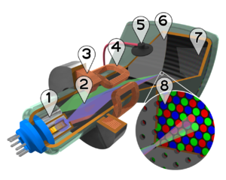
Electron Guns
Electron Beams
Focusing Coils
Deflection Coils
Anode Connection
Shadow Mask
Phosphor layer
Close-up of the phosphor coated inner side of the screen

Slide 11
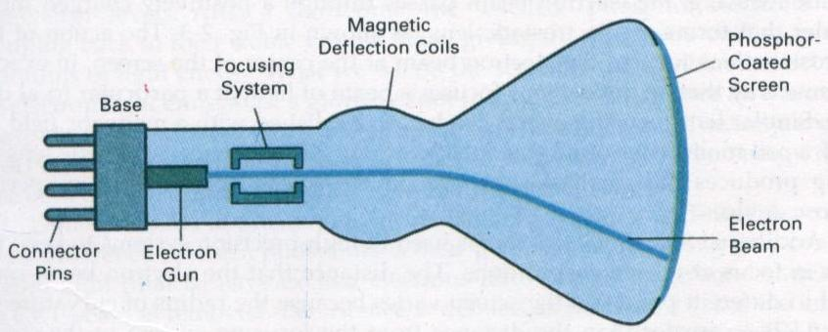
Cathode Ray Tube (CRT)

Slide 12
Refresh CRT
Light emitted by the Phosphor fades very rapidly.
Refresh CRT: One way to keep the phosphor glowing is to redraw the picture repeatedly by quickly directing the electron beam back over the same points.

Slide 13
Electron Gun

Slide 14
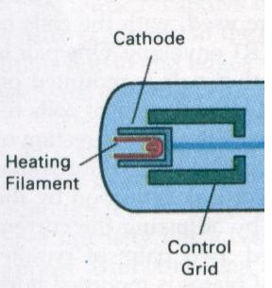
Electron Gun
Heat is supplied to the cathode by the filament.

Slide 15
Electron Gun
The free electrons are then accelerated toward the phosphor coating by a high positive voltage or the accelerating anode is used.

Slide 16
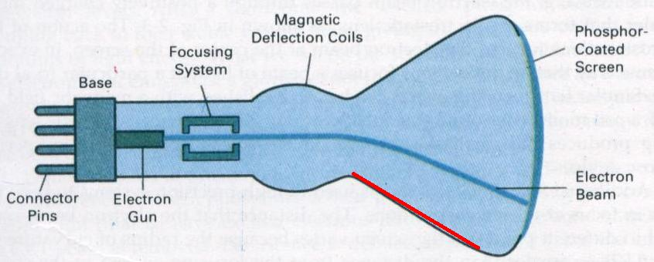
High Positive Voltage
A positively charged metal coating on the inside of the CRT envelope near the phosphor screen.
A positively charged metal

Slide 17
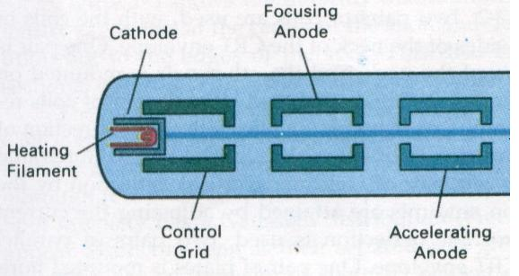
High Positive Voltage
An accelerating anode .

Slide 18
Electron Gun
Intensity of the electron beam is controlled by setting voltage level on the control grid.

Slide 19
Electron Gun
A smaller negative voltage on the control grid simply decrease the number of electrons passing through.

Slide 20
Focusing System

Slide 21
Focusing System
The focusing system is needed to force the electron beam to converge into a small spot as it strikes the phosphor.
Electrostatic focusing is commonly used in computer graphics monitor.

Slide 22
Focusing System
With electrostatic focusing, the electron beam passes through a positively charged metal cylinder that forms an electrostatic lens.

Slide 23
Focusing System
Similar lens focusing effects can be accomplished with a magnetic field set up by a coil mounted around the outside of the CRT envelope.

Slide 24
Focusing System
The distance that the electron beam must travel to different points on the screen varies because the radius of curvature for most CRTs is greater than the distance from the focusing system to the screen center.

Slide 25
Focusing System
The electron beam will be focused properly only at the center of the screen.
As the beam moves to the outer edges of the screen, displayed images become blurred.
Dynamically focusing lens work based on beam position.

Slide 26
Deflection Systems

Slide 27
Deflection Systems
Deflection of the electron beam can be controlled either with electric fields or with magnetic fields.
The magnetic deflection coils mounted on the outside of the CRT envelope.

Slide 28
Deflection Systems
Two pairs of coils are used, with the coils in each pair mounted on opposite sides of the neck of the CRT envelope.

Slide 29
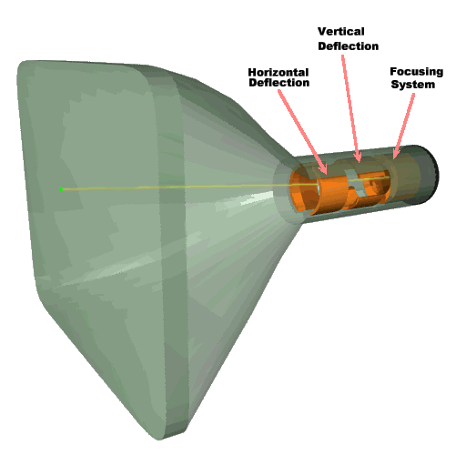
Deflection Systems
One pair is mounted on the top and bottom of the neck, and the other pair is mounted on opposite sides of the neck.

Slide 30
Deflection Systems
Horizontal deflection is accomplished with one pair of coils, and vertical deflection by the other pairs.
The proper deflection amounts are attained by adjusting the current through the coil.

Slide 31
Deflection Systems
Electrostatic deflection: Two pairs of parallel plates are mounted inside the CRT envelope.

Slide 32
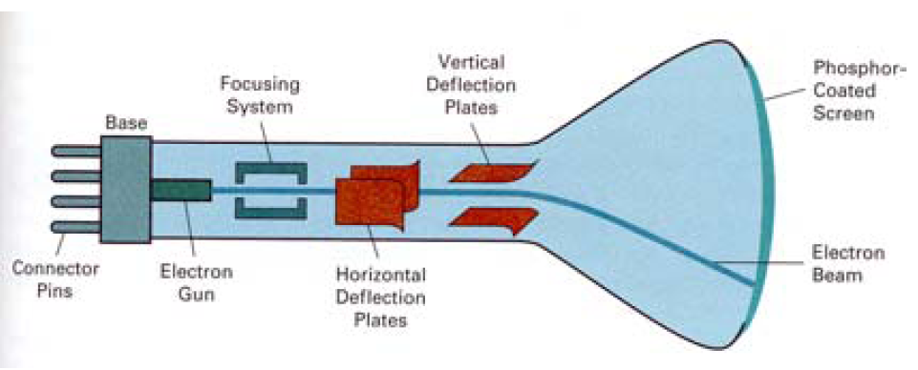
Deflection Systems
One pair of plates is mounted horizontally to control the vertical deflection, and the other pair is mounted vertically to control horizontal deflection.

Slide 33
Spots of Light

Slide 34
Spots of Light
Spots of lights are produces on the screen by the transfer of the CRT beam energy to the phosphor.
Part of the beam energy is converted into heat energy.

Slide 35
Spots of Light
The excited phosphor electrons begin dropping back to their stable ground state, giving up their extra energy as small quantums of light energy.

Slide 36
Persistence
Persistence :The time it takes the emitted light from the screen to decay to one-tenth of its original intensity.

Slide 37
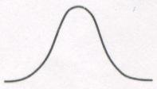
Intensity Distribution
The intensity is greatest at the center of the spot, and decrease with Gaussian distribution out to the edges of the spot.

Slide 38
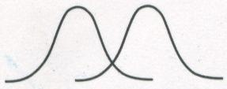
Resolution (Spots of Light)
Resolution: The maximum number of points that can be displayed without overlap on a CRT.
Overlap

Slide 39
Resolution (Spots of Light)
Resolution of a CRT is dependent on:
The type of phosphor
The intensity to be displayed
The focusing and deflection systems.
Typical resolution: 1280 by 1024

Slide 40
Aspect Ratio
Aspect Ratio: This numbers gives the ratio of vertical points to horizontal points necessary to produce equal length lines in both directions on the screen.

Slide 41
Electron Guns
Electron Beams
Focusing Coils
Deflection Coils
Anode Connection
Shadow Mask
Phosphor layer
Close-up of the phosphor coated inner side of the electron

Slide 42
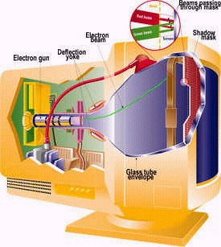
Cathode Ray Tube (CRT)
Beam passing through mask
Anode Connection
Electron Beam
Shadow mask
Deflection Coils
Electron Gun

Slide 43
Entire Working of CRT
A CRT consists of three basic parts: the electron gun assembly, the phosphor viewing surface, and the glass envelope. The electron gun assembly consists of a heated metal cathode surrounded by a metal anode.
The cathode is given a negative electrical voltage and the anode a positive voltage. Electrons from the cathode flow through a small hole in the anode to produce a beam of electrons.
The electron gun also contains electrical coils or plates which accelerate, focus, and deflect the electron beam to strike the phosphor viewing surface in a rapid side-to-side scanning motion starting at the top of the surface and working down.

Slide 44
The phosphor viewing surface is a thin layer of material which emits visible light when struck by the electron beam.
The chemical composition of the phosphor can be altered to produce the colors white, blue, yellow, green, or red.
The glass envelope consists of a relatively flat face plate, a funnel section, and a neck section.
The phosphor viewing surface is deposited on the inside of the glass face plate, and the electron gun assembly is sealed into the glass neck at the opposite end.
The purpose of the funnel is to space the electron gun at the proper distance from the face plate and to hold the glass envelope together so that a vacuum can be achieved inside the finished tube.

Slide 45
Refresh Rate
Alternatively referred to as frame rate, horizontal scan rate, vertical frequency, or frequency.
Refresh rate is a CRT monitor measurement in Hz that indicates how many times per second a monitor screen image is renewed. For example, a monitor with a refresh rate to 75 Hz means the screen is going to redraw 75 times per second.
Refresh rates below 75 Hz can produce an often-imperceptible flicker that can cause eyestrain after long viewing.
While some cards can support as high as 120 Hz, sometimes even higher, it is recommended you run 85-90 Hz; rates beyond 90 Hz add an unnecessary processing burden to the eyes.

Slide 46
Raster Scan Displays
Raster: A rectangular array of points or dots
Pixel: One dot or picture element of the raster
Scan Line: A row of pixels

Slide 47
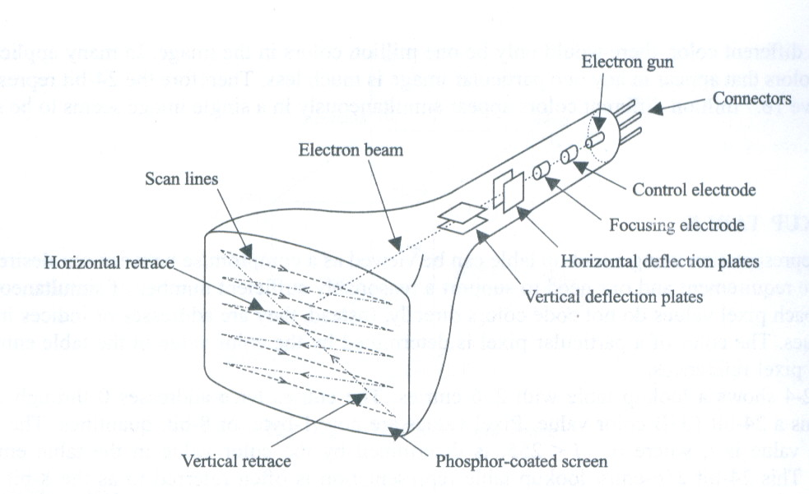
Raster Scan Displays
In a raster scan system, the electron beam is swept across the screen, one row at a time from top to bottom.

Slide 48
Raster Scan Displays
As the electron beam moves across each row, the beam intensity is turned on and off to create a pattern of illuminated spots.

Slide 49
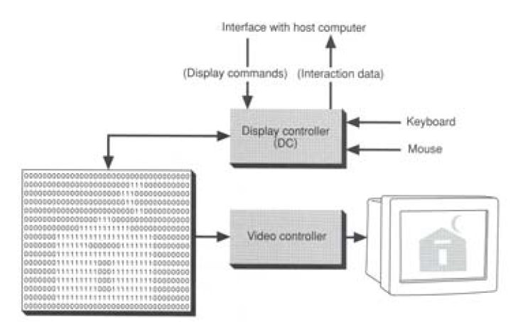
Raster Scan Displays
Picture definition is stored in a memory area called the refresh buffer or frame buffer.

Slide 50
Raster Scan Displays
Refresh buffer or frame buffer: This memory area holds the set of intensity values for all the screen points.

Slide 51
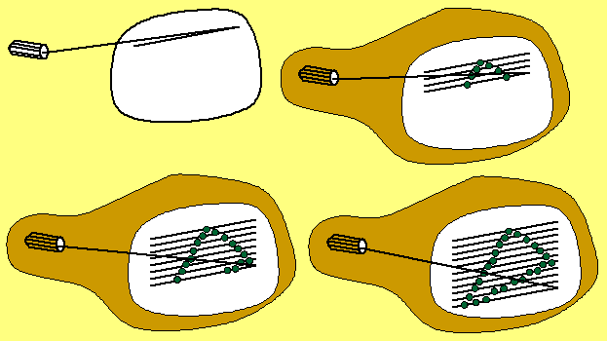
Raster Scan Displays
Stored intensity values then retrieved from refresh buffer and “painted” on the screen one row (scan line) at a time.

Slide 52
Raster Scan Displays
Intensity range for pixel positions depends on the capability of the raster system.
A black-and-white system: each screen point is either on or off, so only one bit per pixel is needed to control the intensity of screen positions.

Slide 53
Raster Scan Displays
On a black-and-white system with one bit per pixel, the frame buffer is called bitmap.
For system with multiple bits per pixel, the frame buffer is called pixmap.

Slide 54
Raster Scan Displays
Sometimes, refresh rates are described in unit of cycles per second, or Hertz (HZ)

Slide 55
Raster Scan Displays
Refreshing on raster scan displays is carried out at the rate 60 to 80 frame per second.

Slide 56
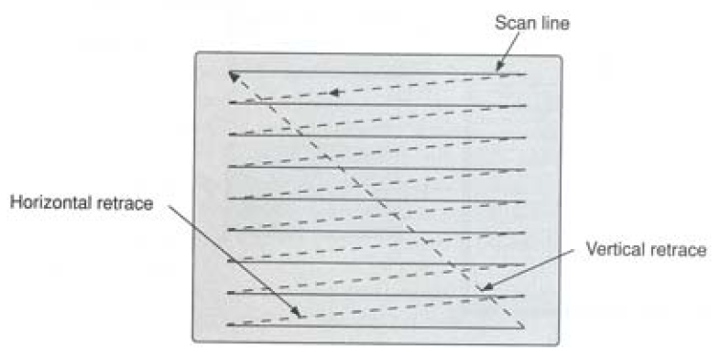
Raster Scan Displays
Horizontal retrace: The return to the left of the screen, after refreshing each scan line.

Slide 57
Raster Scan Displays
Vertical retrace: At the end of each frame (displayed in 1/80th to 1/60th of a second) the electron beam returns to the top left corner of the screen.

Slide 58
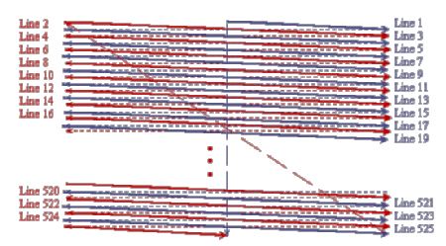
Interlacing
On some raster systems (TV), each frame is displays in two passes using an interlaced refresh procedure.

Slide 59
Interlacing
On an older, 30 frame per-second, noninterlaced display, some flicker is noticeable.
With interlacing, each of the two passes can be accomplished in 1/60th of a second.
An effective technique for avoiding flicker

Slide 60
Raster image
The quality of a raster image is determined by the total number pixels (resolution), and the amount of information in each pixel (color depth)

Slide 61
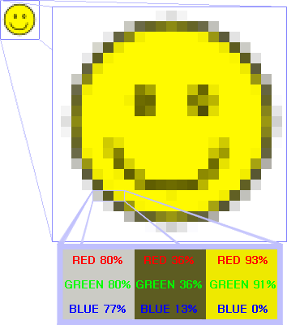
Raster image
Raster graphics cannot be scaled to a higher resolution without loss of apparent quality.

Slide 62
Raster image
Brightness and color @ each x, y on screen

Slide 63
Random Scan Displays

Slide 64
Random Scan Displays
Random scan display is the use of geometrical primitives such as points, lines, curves, and polygons, which are all based upon mathematical equation.
Raster Scan is the representation of images as a collection of pixels (dots)

Slide 65
Random Scan Displays
In a random scan display, a CRT has the electron beam directed only to the parts of the screen where a picture is to be drawn.
Random scan monitors draw a picture one line at a time (Vector display, Stroke –writing or calligraphic displays).

Slide 66
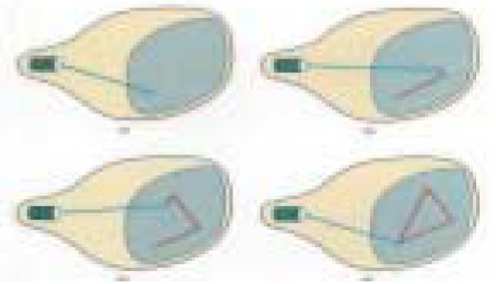
Random Scan Displays
The component lines of a picture can be drawn and refreshed.

Slide 67
Random Scan Displays
The component lines of a picture can be drawn and refreshed.

Slide 68
Random Scan Displays
Refresh rate depends on the number of lines to be displayed.
Picture definition is now stored as a line-drawing commands an area of memory referred to as refresh display file (display list).

Slide 69
Random Scan Displays
To display a picture, the system cycle through the set of commands in the display file, drawing each component line in turn.

Slide 70
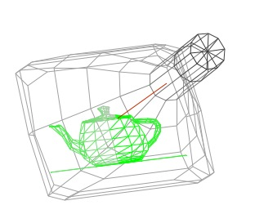
Random Scan Displays
Random scan displays are designed to draw all the component lines of a picture 30 to 60 times each second.

Slide 71
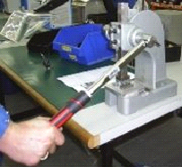
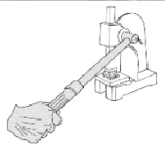
Random Scan Displays
Random scan displays are designed for line-drawing applications and can not display realistic shaded scenes.

Slide 72


Random Scan Displays

Slide 73
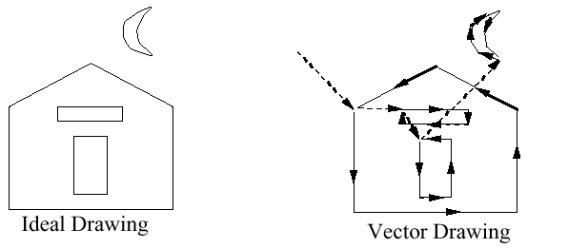
Random Scan Displays
Random scan displays have higher resolution than raster systems.
Vector displays product smooth line drawing.
Ideal Drawing
Vector Drawing

Slide 74
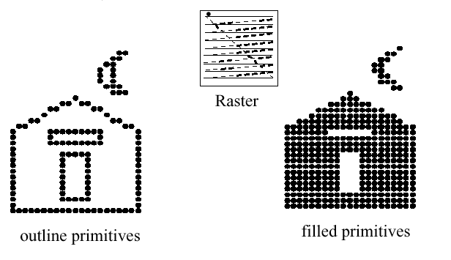
Random Scan Displays
A raster system produces jagged lines that are plotted as discrete points sets.
Raster
Outline primitives
Filled primitives

Slide 75
Random Scan Example
Data are describing a circle:
the radius r
The location of the center point of the circle
Stroke line style and color
Fill style and color

Slide 76
Random Scan Example
Advantages:
This minimal amount of information translates to a much smaller file size. (file size compared to large raster images)
On zooming in, and it remains smooth
The parameters of objects are stored and can be later modified (transformation).

Slide 77
Color CRT Monitors

Slide 78
Color CRT Monitors
A CRT monitor displays color pictures by using a combination of phosphors that emit different color lights.

Slide 79
Methods
1. Beam Penetration
2. Shadow Mask

Slide 80
Beam Penetration Method

Slide 81
Beam Penetration Method
Two layers of phosphor (red and green) are coated onto the inside of the CRT screen.
The display color depends on haw far the electron beam penetrates into the phosphor layers.

Slide 82
Beam Penetration Method
The speed of the electrons, and the screen color at any point, is controlled by the beam acceleration voltage.

Slide 83
Beam Penetration Method
The beam penetration method:
Used with random scan monitors
Only four colors are possible (red, green, orange, and yellow).
Quality of pictures is not as good as with other methods.

Slide 84
Shadow Mask
Method

Slide 85
Shadow Mask Method
The color CRT has:
Three color phosphor dots (red, green and blue) at each point on the screen
Three electron guns, each controlling the display of red, green and blue light.

Slide 86
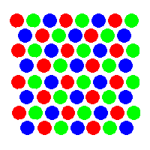
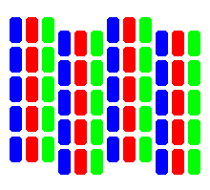
Shadow Mask Method
Delta Method:
In-line Method:

Slide 87
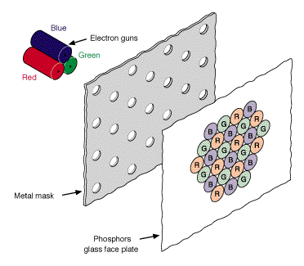
Shadow Mask Method
The delta-delta method:

Slide 88
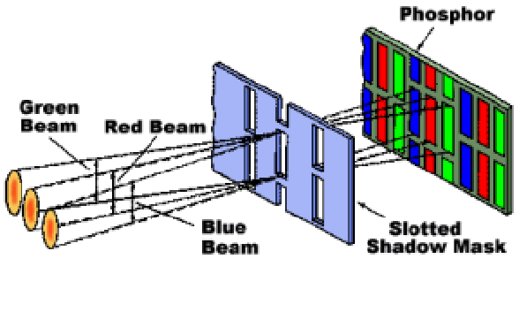
Shadow Mask Method
The in-line method:

Slide 89
Shadow Mask Method
We obtain color variations by varying the intensity levels of the three electron beam.

Slide 90
Shadow Mask Method
Shadow mask methods are:
Used in raster scan system (including color TV)
Designed as RGB monitors.

Slide 91
Shadow Mask Method
High quality raster graphics system have 24 bits per pixel in the frame buffer (a full color system or a true color system)

Slide 92
Color Models

Slide 93
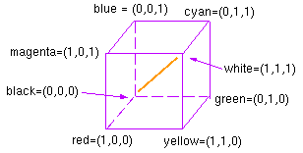
The RGB Color Model
R, G, and B represent the colors produced by red, green and blue phosphors, respectively.
Gray axis

Slide 94
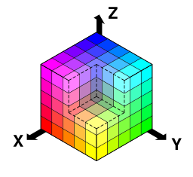
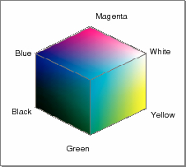
RGB Color Model
RGB color space

Slide 95
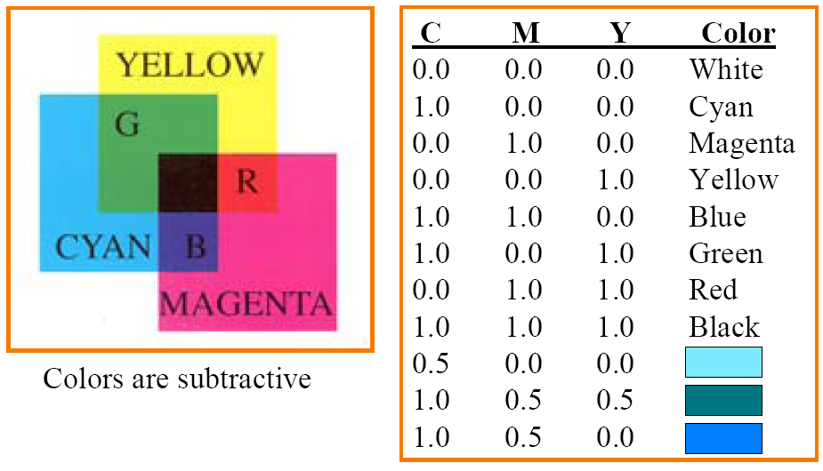
CMY Color Model
CMY (short for Cyan, Magenta, Yellow, and key) is a subtractive color model.

Slide 96


CMY Color Model

Slide 97
Color Depth, Bit Depth
The number of discrete intensities that the video card is capable of generating for each color determines the maximum number of colors that can be displayed.
The number of memory bits required to store color information (intensity values for all three primary color components) about a pixel is called color depth or bit depth.

Slide 98
Color Depth, Bit Depth
A minimum of one memory bit (color depth=1) is required to store intensity value either 0 or 1 for every screen pixel.
If there are n pixels in an image a total of n bits memory used for storing intensity values (in a pure black & white image)

Slide 99
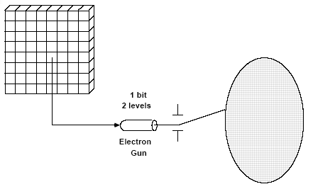
Bit Plane
The block of memory which stores (or is mapped with) intensity values for each pixel (B& W image) is called a bit plane or bitmap.

Slide 100
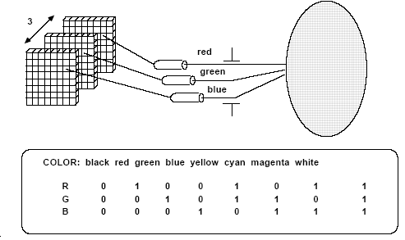
3Bit color display
Color or gray levels can be achieved in the display using additional bit planes.

Slide 101
N Bit Planes
The result for n bits per pixel (color depth=n) is a collection of n bit planes (2^{n} colors or gray shades at every pixel)

Slide 102
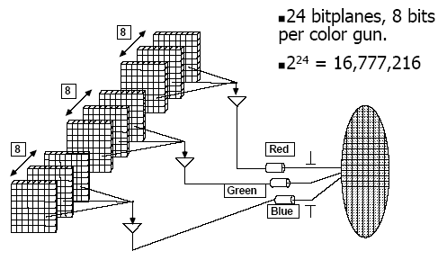
True Color
For true Color three bytes of information are used, one for each of the red, blue and green signals that make a pixel.
A byte can hold 256 different values and so 256 intensities setting are possible for each electron gun which mean each primary color can have 256 intensities (256*256* 256 color possible)

Slide 103
High Color
For high Color two bytes of information are used, to store the intensity values for all three color. This is done by dividing 16 bits into 5 bits for blue, 5 bits for red and 6 bits for green. This means 32(=2⁵) intensities for blue, 32 (=2⁵⁾ for red, and 64 (=2⁶) for green.
Loss of visible image quality.

Slide 104
256 color mode
The PC uses only 8 bits, 2 bits for blue and 3 each for green and red.
Most of the colors of a given picture are not available.
A palette or look-up table is used here.

Slide 105
Color Palette
A palette is a separate memory block (in addition to the 8 bit plane) created 256 different colors.
Each color is defined using the standard 3 byte color definition that is used in true color.
The intensity values for each of the three primary color component can be anything between 0 and 255 in each of the table entries.

Slide 106
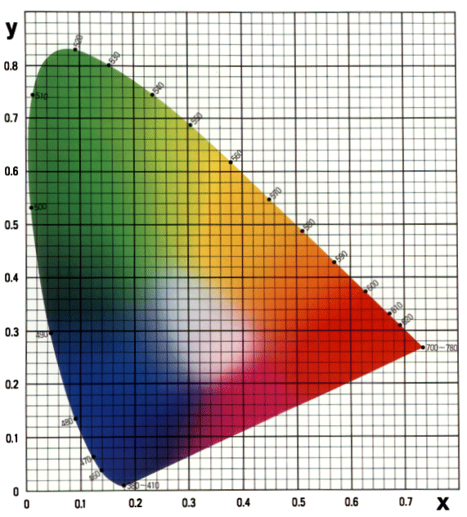
Color Palette
The intensity values for each of the three primary color component can be anything between 0 and 255 in each of the table entries.
Total number of colors available is called color palette.

Slide 107
Raster Scan Systems

Slide 108
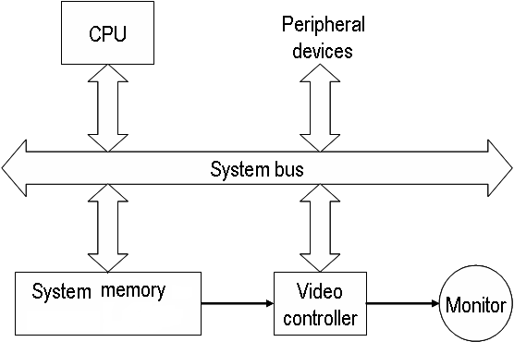
Raster Scan Systems
In addition to the central processing unit (CPU), a special processor, called the video controller or display controller, is used to control the operation of the display device.

Slide 109
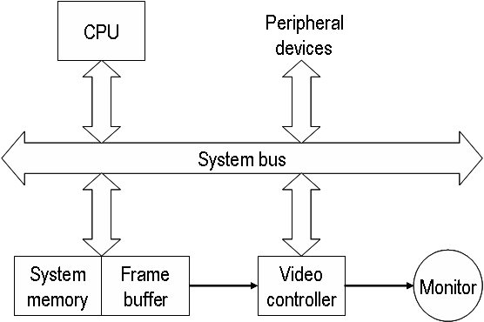
Video Controller
A fixed area of the system memory is reserved for the frame buffer, and the video controller is given direct access to the frame buffer memory.

Slide 110
Video Controller
Frame buffer location, and the corresponding screen positions, are referenced in Cartesian coordinates.
y
x

Slide 111
Video Controller
Scan lines are then labeled from y_{max} at the top of the screen to 0 at the bottom. Along each scan line, screen pixel positions are labeled from 0 to x_{max}.
y
y max
Line Scan
y max
Line Scan
x
x max
x max

Slide 112
Video Controller
Two registers are used to store the coordinates of the screen pixels.
Raster Scan Generator
The Basic refresh operation of the video controller.
x Register
y Register
Memory Address
Frame Buffer
Intensity

Slide 113
Video Controller
Some of operations can be performed by the Video Controller:
Refreshing operation
Transformation (Areas of the screen can be enlarged, reduces, or moved during the refresh cycles)

Slide 114
Raster Scan Display Processor

Slide 115
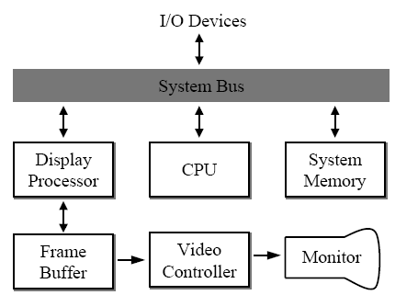
Raster Scan Display Processor
A raster system containing a separate display processor (graphics controller, display coprocessor)
The purpose of the DP is to free the CPU from the graphics chores.

Slide 116
DP
A major task of the display processor is Scan Conversion.
Scan Conversion: is digitizing a picture definition given in an application program into a set of pixel intensity values for storage in the frame buffer.( scan conversion straight line segment, Character )

Slide 117
DP
Generation various line styles (dashed, dotted, or solid)
Displaying color areas
Performing certain transformation and manipulation on display objects.

Slide 118
Random Scan Systems

Slide 119
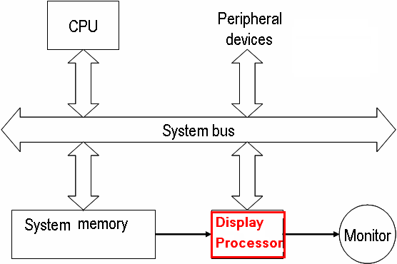
Random Scan System
Graphic commands are translated by the graphics package into a display file stored in the system memory.
This file is then accessed by the display processor unit (DPU)(graphic controller) to refresh the screen.

Slide 120
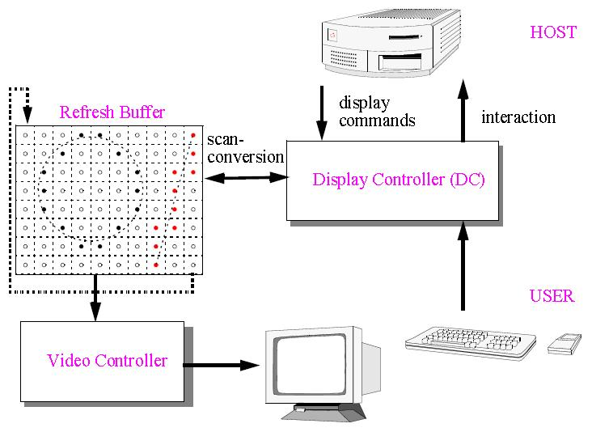
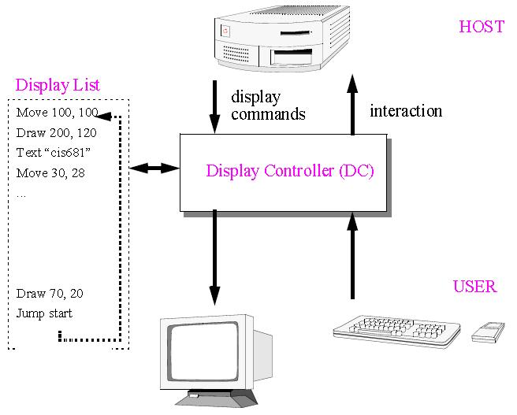
Raster Scan System
Random Scan System

Slide 121
Flat Panel Displays

Slide 122
Flat Panel Displays
A class of video devices that have reduce volume and weight compared to a CRT.
A significant feature of flat panel displays is that they are thinner than CRTs.

Slide 123
Flat Panel Displays
Current uses for flat panel displays:
Small TV monitors
Calculators
Pocket video games
Laptop computers
Advertisement boars in elevators

Slide 124
Flat Panel Displays
Flat panel displays:
Emissive or Emitters Displays
Non-emissive or Non-emitters Displays

Slide 125
Emissive (or Emitters) Displays
Emissive displays convert electrical energy into light.
Examples: Plasma panel, thin-film electroluminescent displays, Light-Emitting Diodes (LED) and flat CRT.

Slide 126
Non-Emissive (or Non-Emitters) Displays
Use optical effects to convert sunlight or light from some other source into graphics pattern.
Example: Liquid-Crystal Device (LCD)

Slide 127
Flat CRT

Slide 128
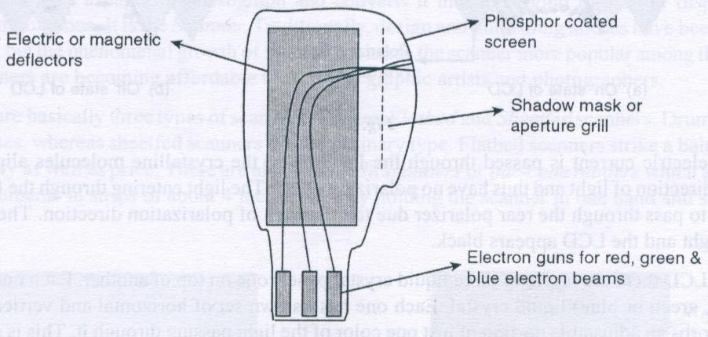
Flat CRT
Electron beams are accelerated parallel to the screen, then deflected 90º to the screen.

Slide 129
Plasma Panel

Slide 130
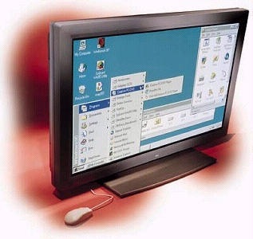
Plasma Panel
A layer of gas (usually neon) is sandwiched between two glass plates.

Slide 131
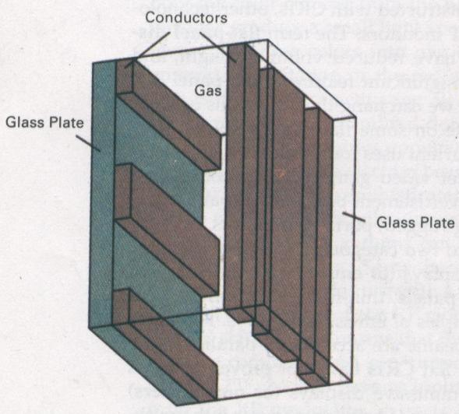
Plasma Panel
By applying high voltage to a pair of horizontal and vertical conductors, a small section of the gas (tiny neon bulb) at the intersection of the conductors break down into glowing plasma of electrons and ions.

Slide 132
Thin Film Electroluminescent

Slide 133
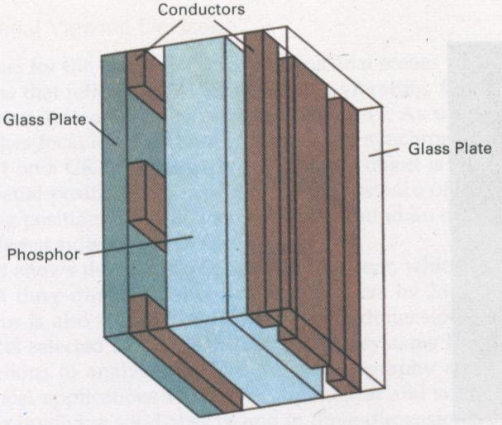
Thin Film Electroluminescent
The region between the glass plates is filled with a phosphor, such as zinc sulfide doped with manganese.

Slide 134
Light Emitting Diode (LED)

Slide 135
Light Emitting Diode (LED)
A matrix of diodes is arranged to form the pixel positions in the display, and picture definition is stored in a refresh buffer.
Information is read from the refreshed buffer and converted to voltage levels that are applied to the diodes to produce the light patterns in the display.

Slide 136
Liquid Crystal Displays (LCD)

Slide 137
Liquid Crystal Displays (LCD)
Used in small systems, such as calculators, laptop computers.
Produce a picture by passing polarized light (from the surrounding or from an internal light source) through a liquid-crystal material that can be aligned to either block or transmit the light.

Slide 138

Liquid Crystal Displays (LCD)
Liquid crystal: These compounds have a crystalline arrangement of molecules, yet they flow like a liquid.

Slide 139
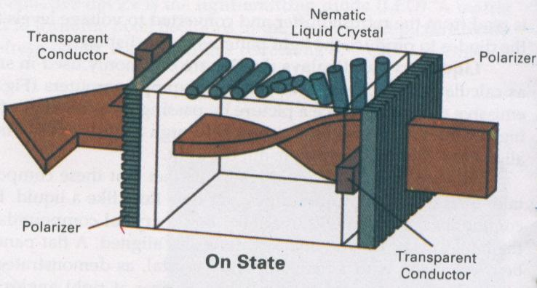
Liquid Crystal Displays (LCD)
Two glass plates, each containing a light polarizer at right angles to the other plate, sandwich the liquid crystal materials.
Rows of horizontal transparent conductor & columns of vertical conductors (put into glass plates)

Slide 140
Liquid Crystal Displays (LCD)
Polarized light passing through the material is twisted so that it will pass through the opposite polarizer.
The light is then reflected back t the viewer.

Slide 141
Liquid Crystal Displays (LCD)

Slide 142
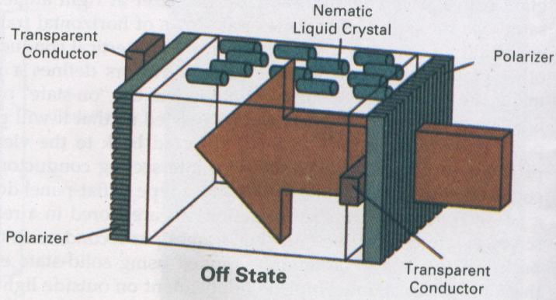
Liquid Crystal Displays (LCD)
To turn off the pixel, we apply a voltage to the two intersecting conductor to align the molecules so that the light is not twisted.

Slide 143
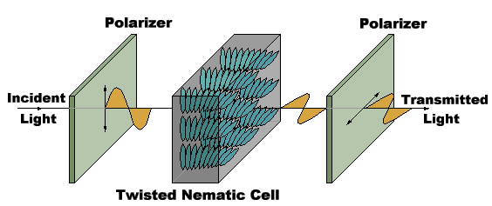
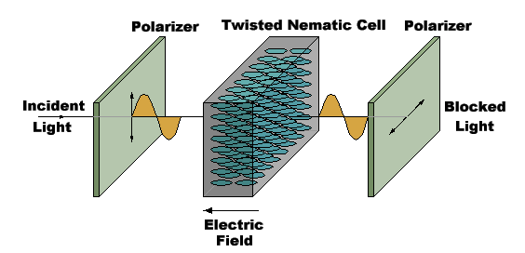
Liquid Crystal Displays (LCD)
On State
Off State

Slide 144
THANK YOU

